Slide 1
Do Now
Draw the Lewis dot structure for the element with the electron notation that ends with 4p5.

Slide 2
Today
Wavelength and Frequency of Light.
Atomic Emission Spectra.
Frequency of light and energy.
Homework: Ch 5 problems 14-16, 21, 22, 30, 32, 35, 37, 41, 42, 54, 55, 56

Slide 3
Properties of Light
Light travels in waves.
Waves have an amplitude, wavelength, and a frequency.
C-Speed of Light = 2.998x10^8m/s.

Slide 4
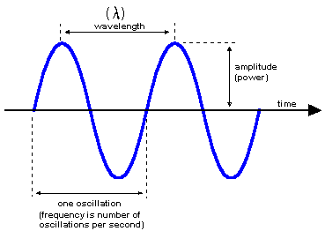
Amplitude, Frequency & Wavelength

Slide 5
C=λV
C-Speed of light. 2.998x10^8 m/s. The speed of light is constant.
λ-Wavelength. The distance in meters between the beginning and end of one full oscillation of a wave.
V-Frequency [Hz]. How often (per second) a full wave passes a given point.

Slide 6
Inverse Proportion
Speed of light is constant.
The longer the wavelength, the less times that a full wave passes a stationary point.
The shorter the wavelength, the more times that a full wave passes a stationary point.

Slide 7
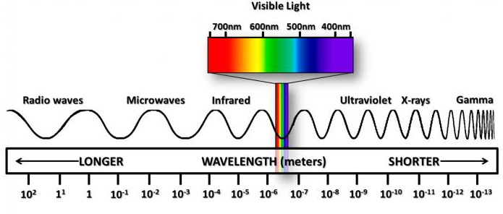
The Electromagnetic Spectrum

Slide 8
The Electromagnetic Spectrum
Radio waves-λ=100m. Low energy.
Light-λ=700 to 380 nm (10^(-9)).
Gamma rays-λ=10^(-14)m.
Light is the only portion of the electromagnetic spectrum that we can perceive. What % of the spectrum is that?

Slide 9
WHAT???!!!
The human eye can only see 3.1x10^(-21) % of the electromagnetic spectrum.
That’s 0.0000000000000000000031%.
With all those other waves flying around, it’s no wonder I can never get a wifi signal.

Slide 10
Determining λ and V
If I have λ I can find V.
If I have V I can find λ.
This is because C is the same for all waves of the electromagnetic spectrum.
C=λV.

Slide 11
The wavelength of the waves in my microwave is 12.2cm. What is the frequency of my microwave oven?

Slide 12
The frequency of x-rays is 3x10^18 Hz. What is the wavelength λ of x-rays?

Slide 13
Green light has a wavelength of 550nm. What is it’s frequency? Hz=1/s.

Slide 14
Atomic Spectra
When atoms absorb energy, their e- move to higher energy levels.
The e- loses that energy quickly and they release light as they return to their original energy level.

Slide 15
Emission Spectra
Depending on the e- configuration, light is released in different frequencies.
This is because they have e- changing on different energy levels.
This makes different materials different colors.

Slide 16
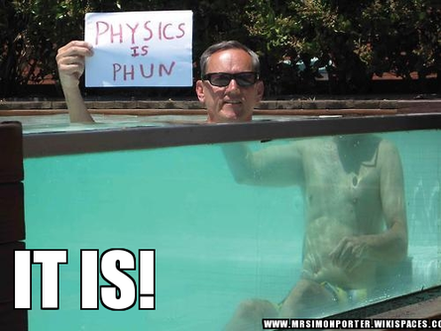
Prisms

Slide 17
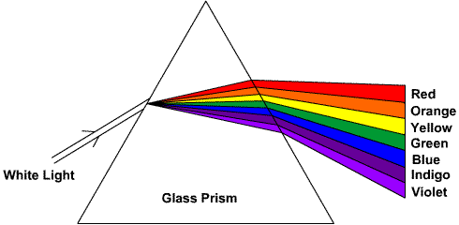
Light “Bends” In a Prism

Slide 18
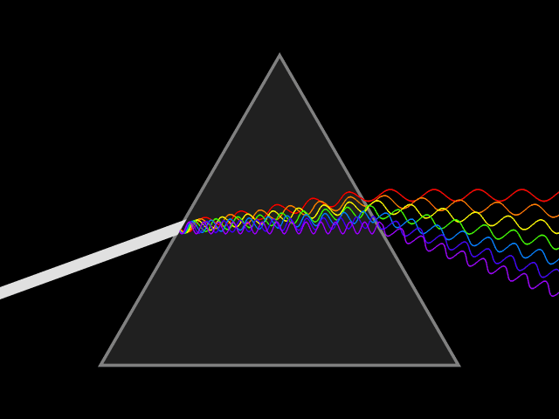
Light Dispersion

Slide 19
e- and Atomic Spectra
Light given off by atoms is directly proportional to the energy change of the electron (quanta).
E=hv
E-Energy is measured in joules [j].
V-still means frequency [1/s].

Slide 20
h-The Plank Constant
A constant value that relates the frequency of light given off by an atom to the energy (quanta) released.
H = 6.626 x 10^(-34) [j/s]

Slide 21
Light with a wavelength of 470nm is emitted by an atom. What is the energy given off by the atom? Answer in joules.

Slide 22
An atom absorbs 2.6x10^9(-40)j. What is the frequency of light emitted by the atom?

Slide 23
Using Frequency (V) to connect λ to E
The V in C= λV has the same value of V in the equation E=hv.
If you can solve for V in one equation, you can find out a value in the other equation.
We are mathemagicians!

Slide 24
The wavelength of AM radio waves is around 30m. What is the energy contained in an AM radio wave? Answer in joules.

Slide 25
An electron releases 3x10^-16 joules of energy. What is the wavelength of the wave emitted by the atom?

